Slide 1
Genetic architecture

Slide 2
Genotype to phenotype
Quantitative genetics developed as a statistical approach to characterising variation
  could not measure genetic effects, so measured patterns of variation to infer underlying genetic effects
How are the two connected?
  How can we describe the genotype-phenotype relationship?
  Start at genotype and examine how loci contribute variation (‘bottom up’)

Slide 3
A gene doesn’t ‘do’ anything
A gene doesn’t make you bigger or smaller etc.
Alleles at a locus are responsible for the differences in phenotypes (if they are genetic in origin)
  gene function often viewed in terms of KOs
  but most allelic variation is not functional vs. non-functional

Slide 4
Start with a locus…
Allelic differences at loci are the origin of variation
  Locus = location in the genome
  Alleles = different DNA sequences at a locus
    e.g., SNPs, Indels (insertions, deletions), CNVs
How does allelic variation at a locus create phenotypic variation we observe
  fundamental question in genetics
  understanding variation

Slide 5
The single locus model
Single locus with two alleles, A₁ and A₂ with frequencies p and q

Slide 6
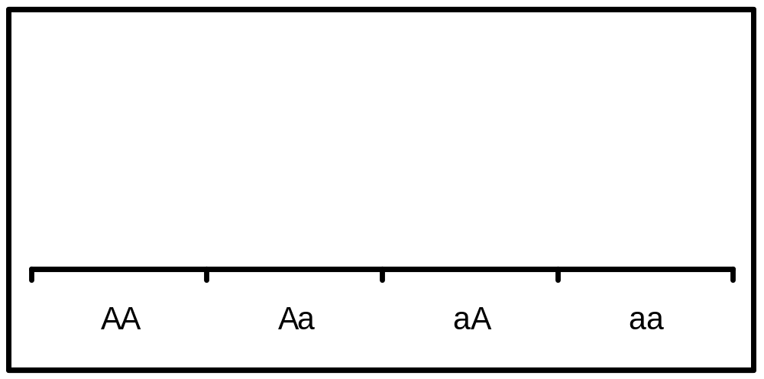
Neutral
The ‘null hypothesis’ when examining the genotype phenotype relationship is that genetic variation does not affect the phenotype
  a = d = 0
3-
Phenotype
2-
1-
A₁A₁ A₁A₂ A₂A₂
Genotype

Slide 7
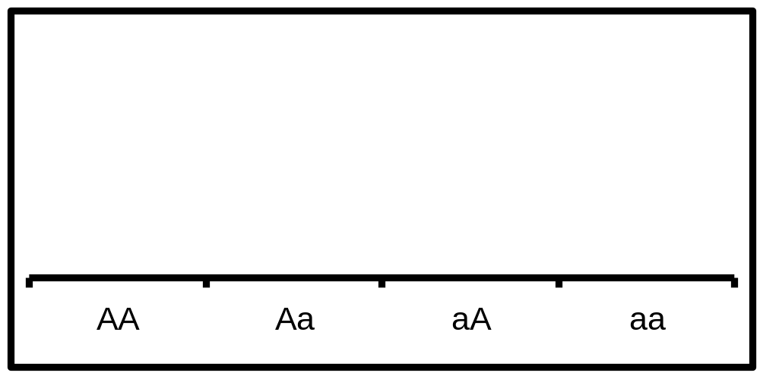
Additive effects
Each A₁ allele adds some value a to the phenotypic value of an individual.
Phenotype
A₁A₁ A₁A₂ A₂A₂
Genotype

Slide 8
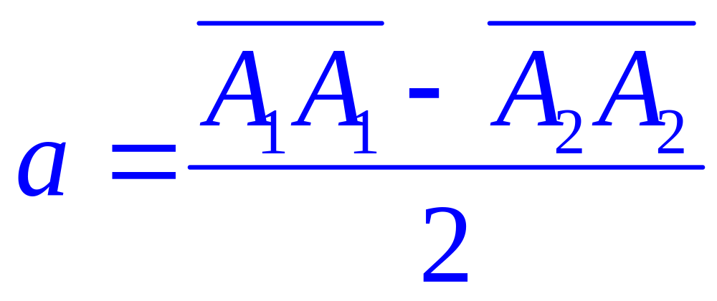
Additive effects
a is the additive effect or additive genotypic value
Defined as half the difference between the means of the two homozygotes

Slide 9
Additive
3-
a
Phenotype
2-
−a
1-
A₁A₁ A₁A₂ A₂A₂
Genotype

Slide 10
Additive
3-
−a
Phenotype
2-
a
1-
A₁A₁ A₁A₂ A₂A₂
Genotype

Slide 11
Dominance effects
The A₁ and A₂ alleles interact, so the heterozygote is not in the position predicted from the sum of the effects of the A₁ and A₂ alleles
Phenotype
A₁A₁ A₁A₂ A₂A₂
AA AB BB
Genotype

Slide 12
Dominance effects
Phenotype
A₁A₁ A₁A₂ A₂A₂
AA AB BB
Genotype

Slide 13
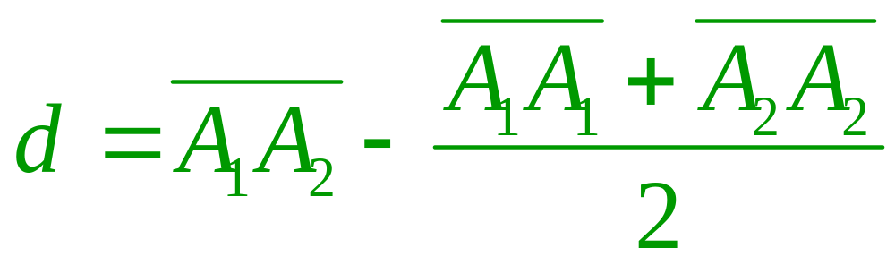
Dominance effects
d is the dominance effect or dominance genotypic value
Defined as the deviation of the heterozygote from the average of the homozygotes

Slide 14
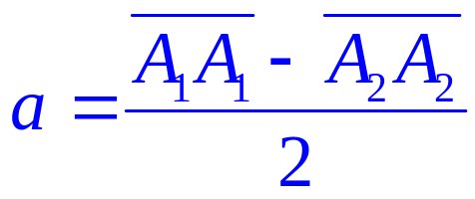

Characterizing genetic effects
So, with a single locus and 2 alleles, effects are summarized by two parameters
additive
Phenotype
X
A₁A₁ A₁A₂ A₂A₂
AA AB BB
dominance
Genotype

Slide 15
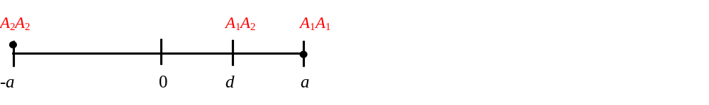
Characterizing genetic effects
Another way to visualize effects
Mean of the homozygotes is given the value zero
  all value measured relative to the mean of the homozygotes

Slide 16
Complete dominance
In a quantitative genetics framework, complete dominance (classical dominance) involves both an additive and dominance effect
  ǀaǀ = ǀdǀ ≠ 0
3-
a
d
Phenotype
2-
−a
1-
A₁A₁ A₁A₂ A₂A₂
Genotype

Slide 17
Partial dominance
There can be dominance that is ‘incomplete’, so the heterozygote is closer to one homozygote than it is to the other
  ǀaǀ > ǀdǀ
3-
a
d
Phenotype
2-
−a
1-
A₁A₁ A₁A₂ A₂A₂
Genotype

Slide 18
Overdominance
Heterozygote phenotype is greater than that of either homozygote (really refers to the effect on Darwinian fitness)
ǀaǀ < d, d > 0
3-
d
a
Phenotype
2-
−a
1-
A₁A₁ A₁A₂ A₂A₂
Genotype

Slide 19
Overdominance
Can also find that there is dominance, but no additive effect
  a = 0, d > 0
3-
d
Phenotype
2-
1-
A₁A₁ A₁A₂ A₂A₂
Genotype

Slide 20
Underdominance
Heterozygote phenotype is less than that of either homozygote (again, really refers to the effect on Darwinian fitness)
  ǀaǀ > d, d < 0
3-
d
Phenotype
2-
1-
A₁A₁ A₁A₂ A₂A₂
Genotype

Slide 21
Why do we care?
Additive & dominance effects contribute to components of variation
  Population mean, evolution of the mean
  Heritable and non-heritable variation
  Evolutionary change in allele frequencies
Connect genotype to phenotype
  selection on phenotypes causes changes in genotypes through the genotype-phenotype relationship

Slide 22
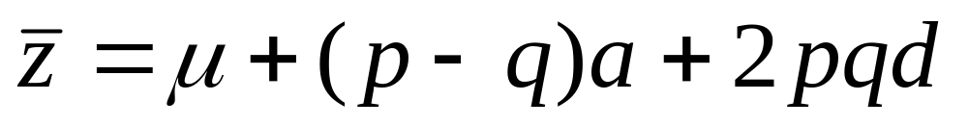
Mean phenotype
Contribution of a locus to the population mean is determined by the pattern of effect
If a locus is in HWE, then:

Slide 23
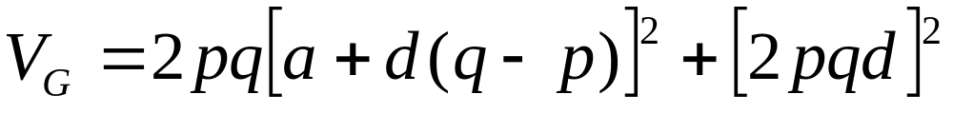
Genetic variance
The variance is the average squared deviation from the mean – measures variability in a population
Genetic variance represents the phenotypic variance among different classes of genotypes
Genetic effects are what create patterns of variation

Slide 24
Linking genotype-phenotype relationship to components of variation (and evolution)
… continued

Slide 25
Heritable variation
Back to the problem of understanding heritable versus non-heritable variation
  A correction
  … and extended concepts

Slide 26
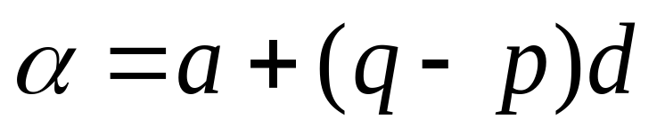
Average effect of an allele substitution
Phenotype
slope is the average effect of an allele substitution (α) – substituting A₁ for A₂
0 1 2
A₂A₂ A₁A₂ A₁A₁
Number of A₁ alleles
Genotype

Slide 27
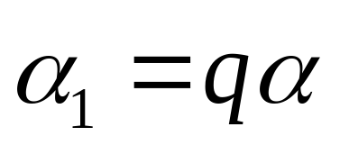
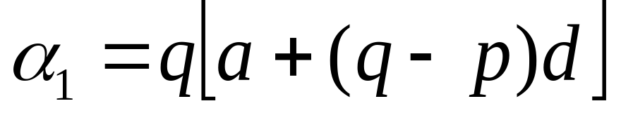
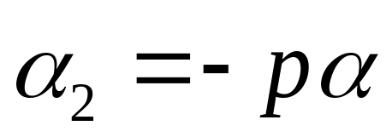
Average effect of alleles
The average effect of the A₁ allele is
And the A₂ allele is

Slide 28
Breeding values
The breeding value of a genotype is the sum of the average effects of the alleles possessed by that genotype
So it predicts what the offspring of a genotype will ‘look like’, on average
  b(A₁A₁) = 2α₁
  b(A₁A₂) = α₁ + α₂
  b(A₂A₂) = 2α₂

Slide 29
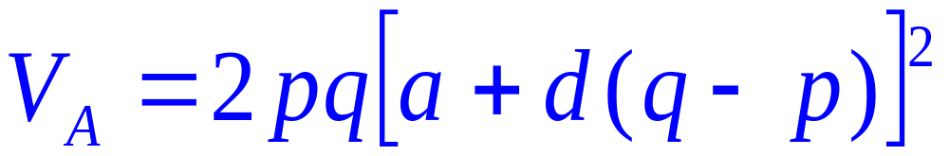
Additive genetic variance
Twice the variance in average effects of alleles the heritable (additive genetic) variance
This is the variance in breeding values
  Heritable additive genetic variation can arise from both additive and dominance effects

Slide 30
Non-heritable variation
The observed phenotype and the breeding value are typically not the same
The difference has two components
  Environmental effects that cause random deviations
  Non-heritable types of genetic variation
What makes genetic variation non-heritable?

Slide 31
Non-heritable genetic variation?
Genetic variation that relies on combinations of alleles may not be heritable if the combinations are not predictable
Consider dominance:
  The effect of an allele is dependent on the allele it is partnered with
  But the degree to which this influence is not predictable is dependent on allele frequencies

Slide 32
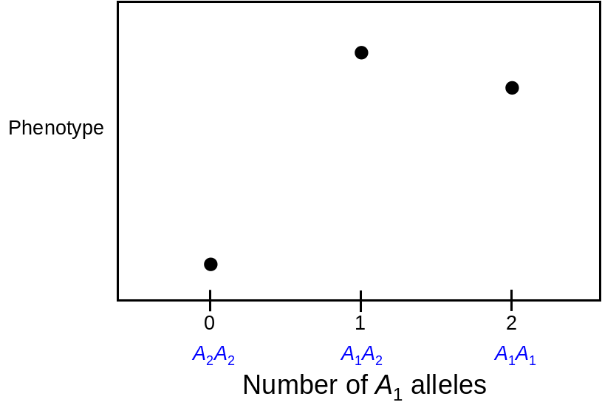
Influence of dominance can be ‘predictable’
A₁ allele is rare
Alleles at the same frequency
p = 0.1,
q² = 0.81, 2pq = 0.18, p² = 0.01
p = 0.5,
q² = 0.24, 2pq = 0.50, p² = 0.25

Slide 33
Dominance deviations
Observed phenotype
dominance deviations
Phenotype
Expected phenotype based on alleles (so breeding value)
0 1 2
A₂A₂ A₁A₂ A₁A₁
Genotype

Slide 34
Dominance deviations
Dominance deviation = difference between genotypic value (mean phenotype of a genotype) and the breeding value
  Due to interactions between alleles at a locus,
    not a direct measure of dominance
  An analogous phenomenon exists for interactions between alleles at different loci

Slide 35
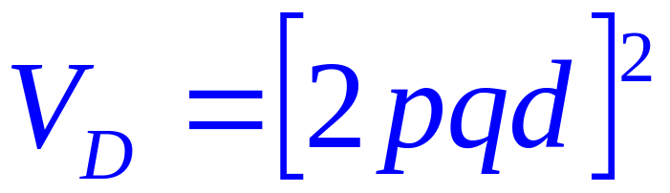
Dominance variance
Variance in dominance deviations is the dominance variance
Is non-heritable
Caused entirely by dominance
Can contribute to resemblance of relatives that share genotypes (like siblings)

Slide 36
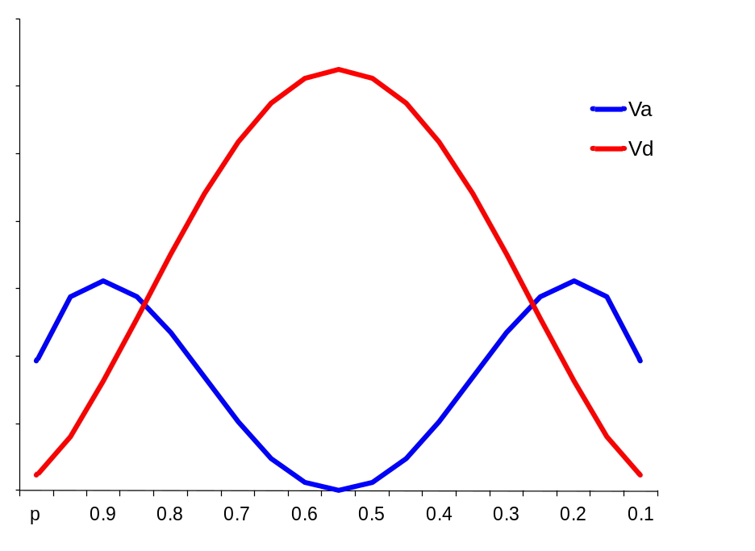
Dominance variance
Dominance gene action can produce both additive and dominance variance
All of the variation is dominance
Most variation is additive
V_{A}
V_{D}
Variance
Allele frequency (p)

Slide 37
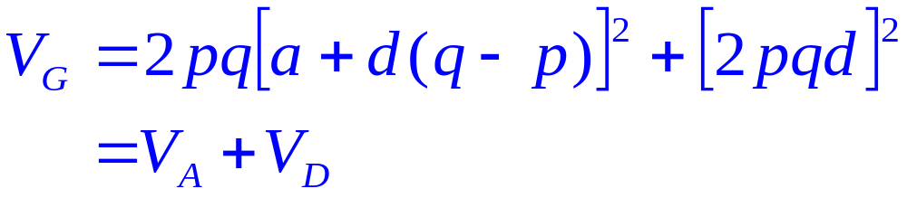
Genetic variance
Is the sum of additive and dominance variances
But only the additive part contributes to the resemblance of offspring and their parents
  - i.e., is heritable

Slide 38
Alleles and loci have no fixed effect
Effects of alleles are really about contrasts between the different genotypes at a locus
  Does the A allele make you bigger? Depends on how it influences the phenotype relative to other allele(s) at a locus
  Depends on frequencies of other alleles
Effect of a locus depends on the alleles present
  Does a locus show dominance? Depends on what alleles there are in the population we are examining

Slide 39
Empirical analysis

Slide 40
QTL analysis
A Quantitative Trait Locus (QTL) is a location in the genome that causes different values of the trait in question
A QTL does not have to be a ‘gene’ in the traditional sense – e.g., alleles can be differences in some regulatory element
Most importantly, QTL are very often not associated with differences in proteins, but rather, differences in gene expression

Slide 41
QTL analysis
Examine statistical association between genome region and trait variation
  In the simplest case, this is done as an ANOVA, where:
Trait value = genotype + error
This model is then tested as you walk across the genome
  Quantitative Trait Locus (QTL) analysis

Slide 42



QTL analysis
Identify genotype classes and test for variation among versus within these classes
A₁A₁
A₁A₂
A₂A₂

Slide 43
QTL analysis
Classic QTL approach uses a population constructed from an F₂ intercross of inbred lines (or other constructed population with high linkage disequilibrium)
Genotype individuals at markers
  Typically three genotype classes (SS, SL, LL)

Slide 44
Tutorial
Let’s start with the tutorial to look at this basic ANOVA model
First a side note on the data structure

Slide 45
Experimental population
Intercross of two inbred lines of mice
  selected for large (Large of LG/J) and small (Small or SM/J) adult body size (60 day body weight)
  Lines differ by 9.5 within-strain standard deviations in body size
  Inbred for ~50 years
Offers opportunity for understanding how quantitative genetic variation contributed to trait evolution
Experimental work in collaboration with Prof. Jim Cheverud (Washington University School of Medicine)

Slide 46
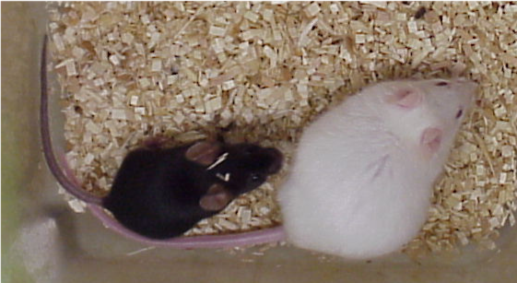
Large (LG/J)
Small (SM/J)
Notes:
I am looking at the genetic architecture of maternal effects in Jim Cheverud’s lab at Washington University as part of my NSF postdoc grant in biological informatics.
I am using an intercross of a large and small line of mice to map differences in maternal effects on early growth. This cross has been used to identify loci influencing body size, but those analyses have ignored the role of maternal effects

Slide 47
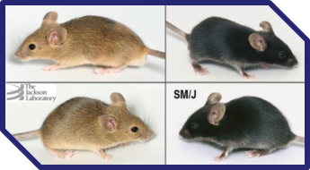
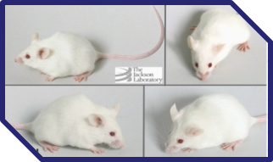
LG/J
Small
Large
(SM/J)
x
(LG/J)
F₁
Experimental population
F₂ F₂ F₂ F₂ F₂ F₂ F₂ F₂
pups cross-fostered
F₃ F₃ F₃ F₃ F₃ F₃ F₃ F₃
F₁₀ F₁₀ F₁₀ F₁₀ F₁₀ F₁₀ F₁₀ F₁₀

Slide 48
Genotypes
Real genotypes (SNPs)
  F₂ (N~500)
  F₃ (N~1600)
  370 SNP loci (ca. 4 cM map – 1500cM genome)
Tutorial data
  Single chromosome (chromosome 1) = 31 markers
  Simulated markers using real pedigree
  Simulated QTL effects

Slide 49
Start with F₂

Slide 50
Phenotypes
Trait 1 = measure of how fat animals are
Trait 2 = length of tail
Trait 3 = weight at time of death
Simulated QTL
  Trait 2a is Trait 2 with a simulated QTL effect
  Trait 3a is Trait 3 with a simulated QTL effect

Slide 51
Variables
Dam and sire are the mother and father
  Either is the same as ‘family’
  Test for the heritability of traits? (using code from yesterday)
Sex is obvious
Fixed effects
  LSB = litter size at birth
  LSW = litter size at weaning

Slide 52
ANOVA results
Means of the three genotype classes?
2 degree of freedom test for significance of the effect of a locus

Slide 53
Effect of the locus?
ANOVA tells us whether there is an overall effect of a locus
  Additive?
  Dominance?
We can use the genotype classes in contrasts to estimate the additive and dominance effects (as defined above)
Or we can use a regression model

Slide 54
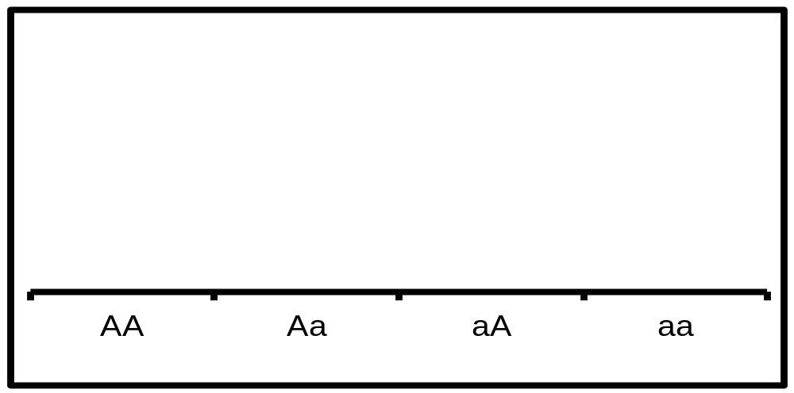
Characterizing QTL effects
With a single locus and 2 alleles, we can separate linear (additive) and dominance effects
additive
Phenotype
X
dominance
LL LS SS
Genotype

Slide 55
Regression model
Create separate indices for additive and dominance effects and do a regression
  Get two single degree of freedom tests, one for additive effect and one for dominance effect

Slide 56
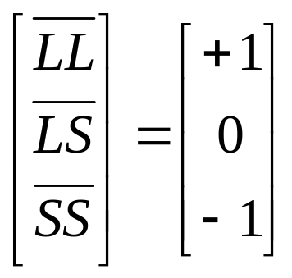
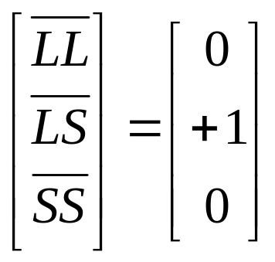
Regression model
Genotypes are assigned index (‘dummy’) variables that allow one to regress the phenotype on the genotype
Additive
  Dominance

Slide 57
Genome-wide model
Next, we can fit this model to each locus as we walk along the genome
This produces a significance ‘profile’ across the genome
Linkage disequilibrium makes adjacent tests correlated
With a large number of markers we end up doing a very large number of tests

Slide 58
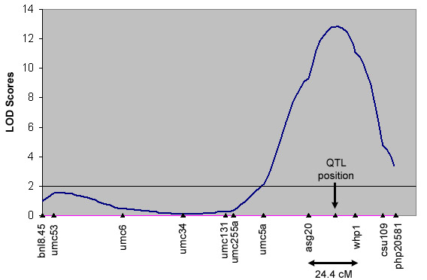
Genome-wide analysis
Significance →
Marker positions across a chromosome

Slide 59
Correcting for multiple testing
We can correct for the multiple testing using a Bonferroni correction
  But it needs to account for the fact that tests of correlated markers are not independent

Slide 60
The problem of LD
Linkage disequilibrium can make it difficult to localize a QTL, especially when a chromosome contains multiple loci
There are strategies to include ‘flanking’ markers to remove the influence of LD

Slide 61
Advanced intercross
Let’s move on to data from the F₃ generation of this intercross
Created by randomly mating F₂ individuals
More recombination (so adjacent markers are less correlated)
  Can keep inter-crossing to break of LD

Slide 62
‘Real’ population
Real populations have ‘structure’ due to relatedness or ‘stratification’
F3 come in families of siblings
Related individuals have correlated genotypes and correlated phenotypes
We will look at the consequences for mapping in the real world

Slide 63
Phenotypes
Trait 1 = spleen weight
Trait 2 = body weight at 3 weeks of age
Trait 3 = body weight at 10 weeks of age
Simulated QTL
  Trait 2a is Trait 2 with a simulated QTL effect
  Trait 3a and 3b are Trait 3 with simulated QTL effects

Slide 64
Variables
Dam and sire are the mother and father
  Either is the same as ‘family’
  Test for the heritability of traits? (using code from yesterday)
Nurse is the individual that raised the animal after birth (can be = dam)
Sex is obvious
Fixed effects
  LSB = litter size at birth
  LSW = litter size at weaning

Slide 65
Power and inference issues
We can correct for the multiple testing using a Bonferroni correction
  But it needs to account for the fact that tests of correlated markers are not independent
You can simulate a real QTL on top of your data and test for how often it is identified as significant
  Power
QTL analysis is biased because of the multiple testing problem

Slide 66
Multiple traits
Often a single locus affects multiple traits
So treating traits are independent in separate analyses doesn’t make sense
  And can lead to a loss of power and inference

Slide 67
Pleiotropy
One locus affects more than one trait
Causes, e.g.
  Same gene expressed in different tissues
  Shared developmental basis
  Physical interactions (muscle on bone, tissue fields)
  Causal, where trait 1 causes trait 2, like high resting metabolic rate and body weight
  Autocorrelation (like height at year 1 and height at year 2)

Slide 68
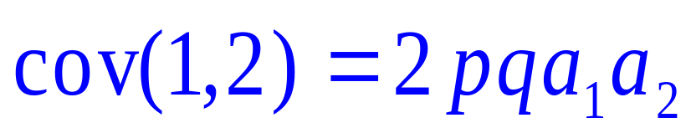
Additive effect on two traits
A₂A₂
Trait 2
A₁A₂
A₁A₁
Trait 1
So this locus leads to a positive genetic covariance/correlation between the two traits

Slide 69
Additive and dominance effect on two traits
A₂A₂
Trait 2
A₁A₂
A₁A₁
Trait 1
Locus shows similar additive and dominance effects on the two traits

Slide 70
Overdominance on two traits
A₁A₂
Trait 2
A₂A₂
A₁A₁
Trait 1

Slide 71
Patterns can be complex
A₁A₂
A₂A₂
Trait 2
A₁A₁
Trait 1
Additive effect on Trait 1
Overdominance effect on Trait 2

Slide 72
Why do we care?
Pleiotropy leads to genetically based correlations between traits
Ultimately determine the multivariate response to selection

Slide 73
Interactions among multiple loci
We have treated the influence of a locus as independent from other loci
But it is possible for the effect of a locus to depend on alleles present at another locus of loci
This is ‘epistasis’ – we will return to this problem Thursday

